Slide 1



Introduction to data assimilation
Sibo Cheng

Slide 2

Outline
What is data assimilation(DA)?
Variational and sequential DA
BLUE
Kalman Filter
3D-Var and 4D-Var
Implementation challenges in DA
Error covariance specification
Nonlinearity
Large dimension
Applications and Examples in Python
Lorenz
Shallow water
Hydrology
DA with model reduction

Slide 3
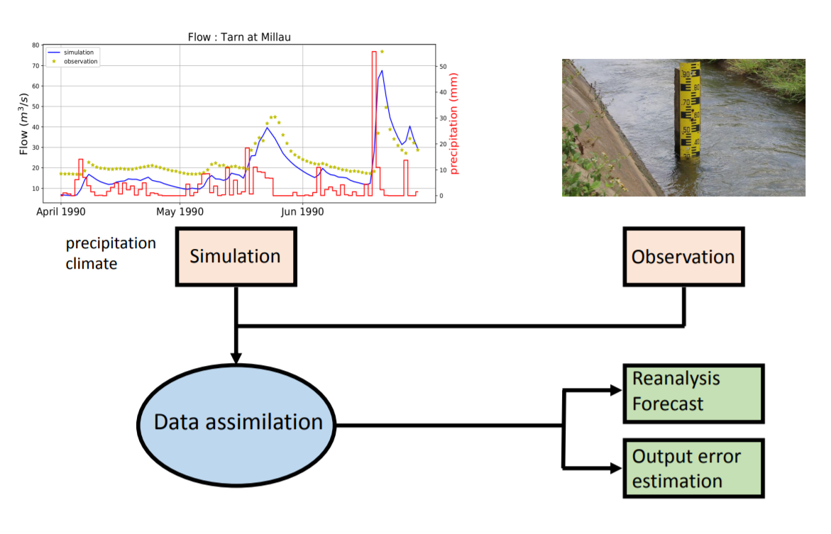
What is data assimilation
Objective: combine different sources of noisy information to estimate a physical field or a set of parameters
Prior estimation
Observation
Model equations

Slide 4
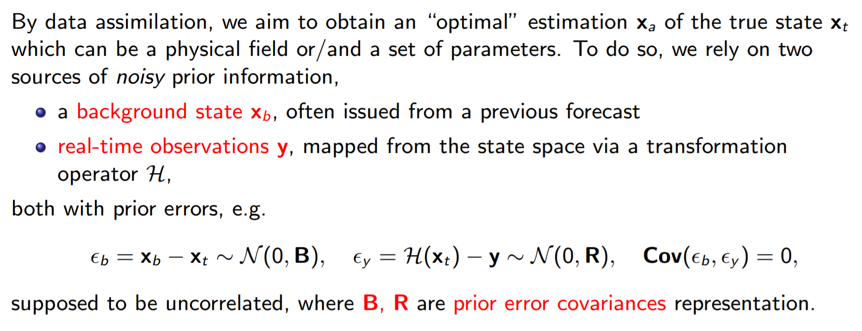
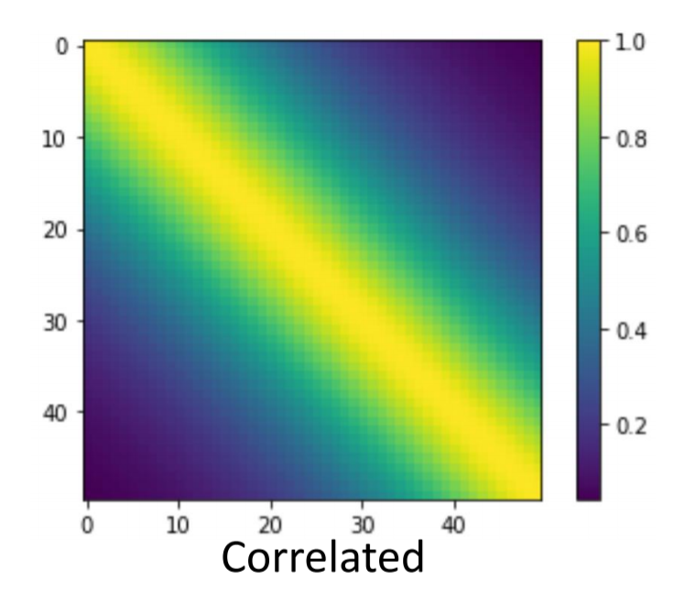
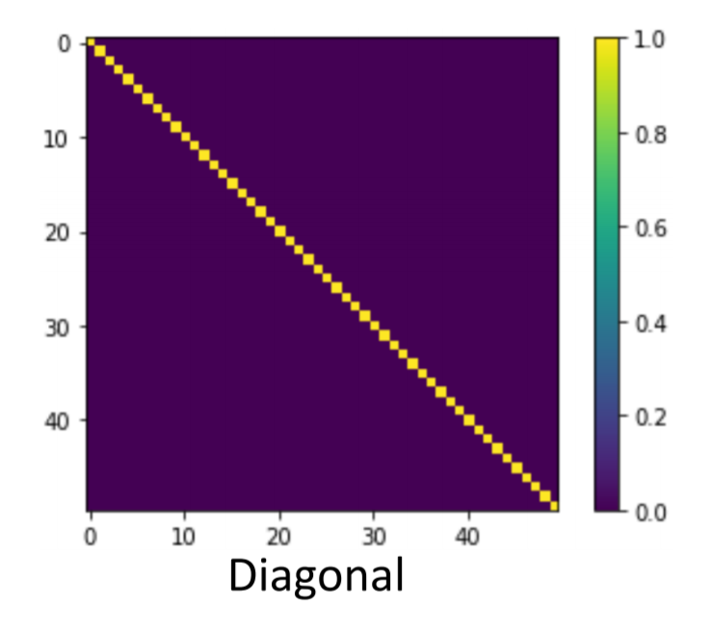
Notation and assumptions
Variational and sequential DA

Slide 5
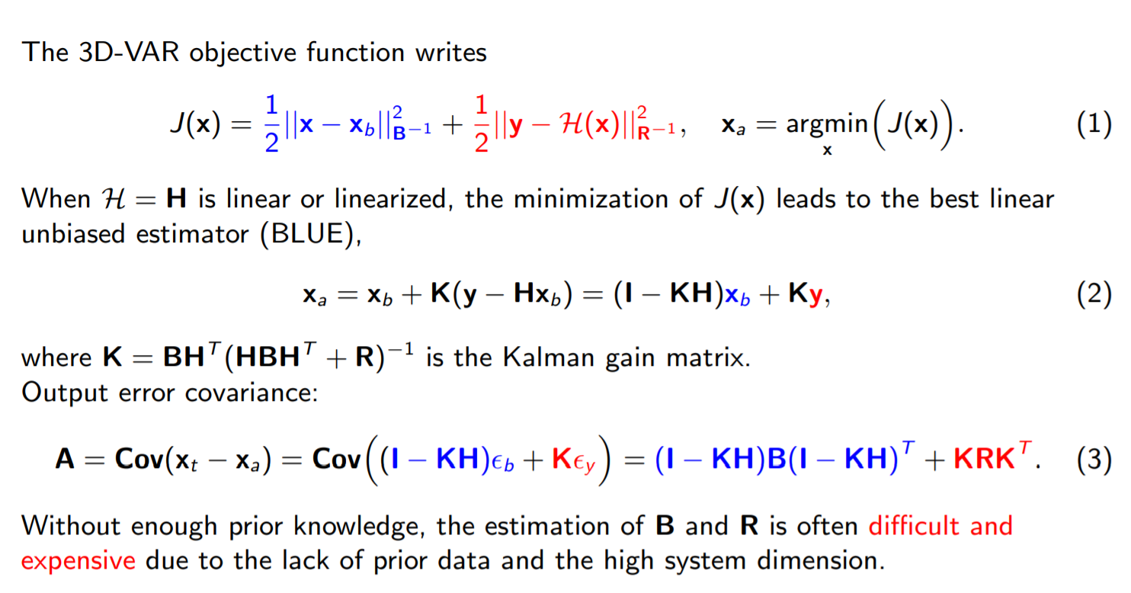
DA formulation: BLUE
Variational and sequential DA

Slide 6
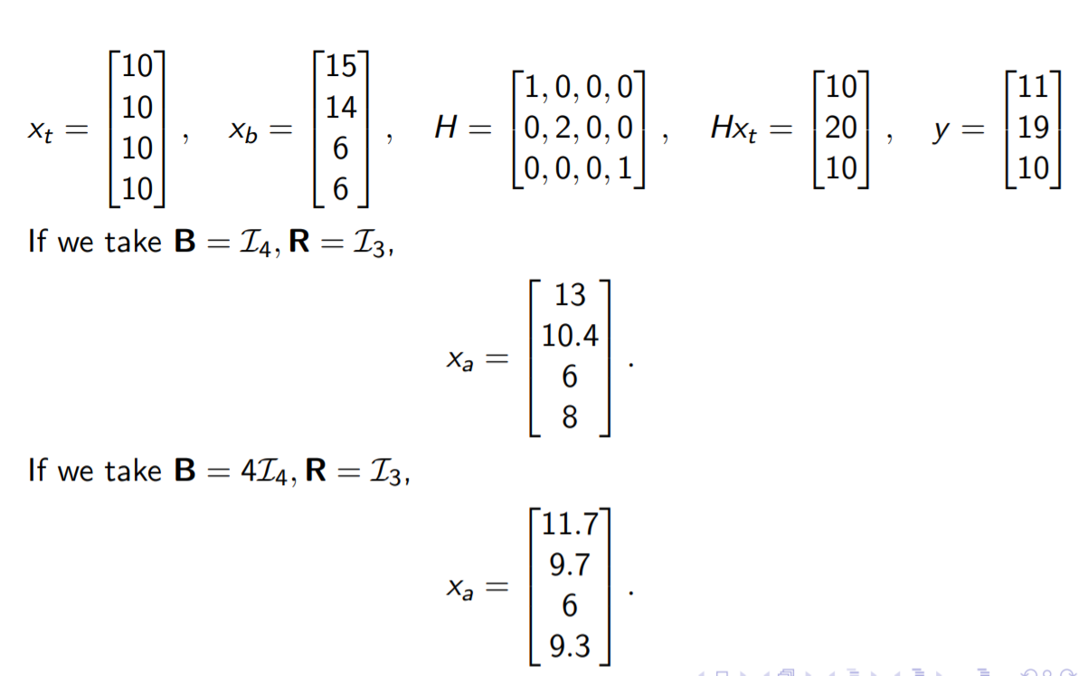
A simple example
Variational and sequential DA

Slide 7
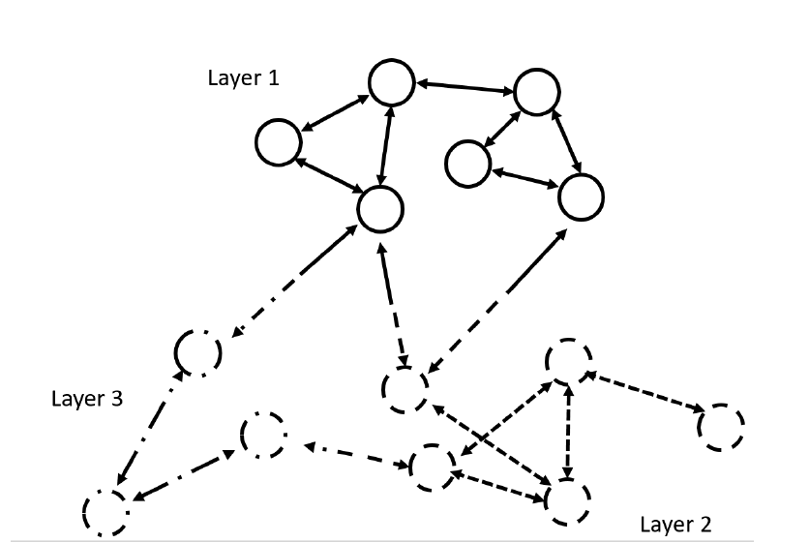
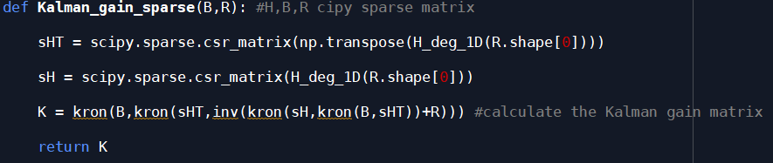
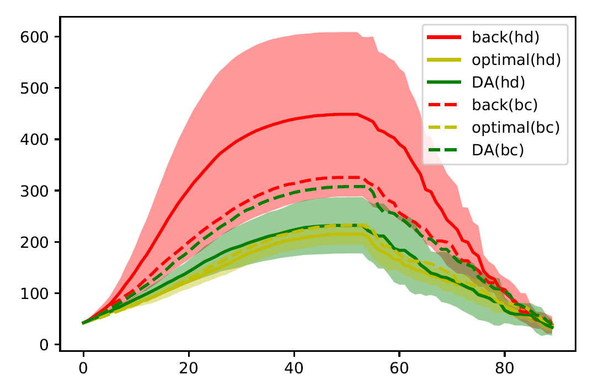
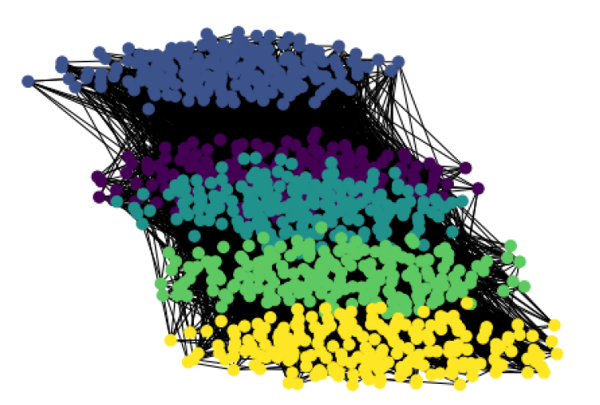
Example: vaccination strategy for Covid-19
Variational and sequential DA
Matrix computation can be performed offline
Number of infected
[Cheng et al, 2021], Optimal vaccination strategies for COVID-19 based on dynamical social networks with real-time updating
Time steps

Slide 8
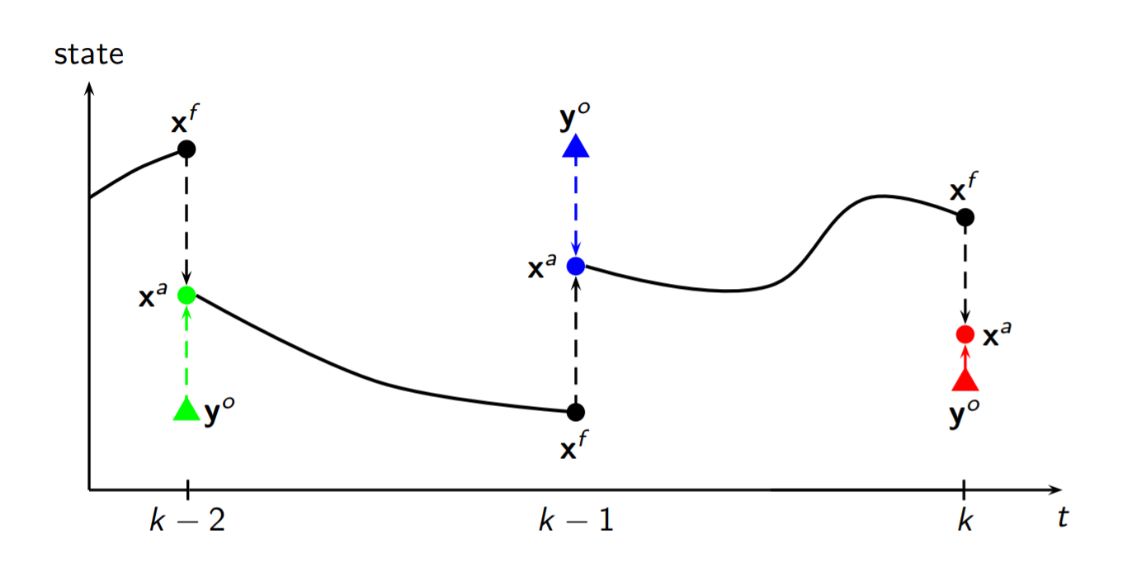
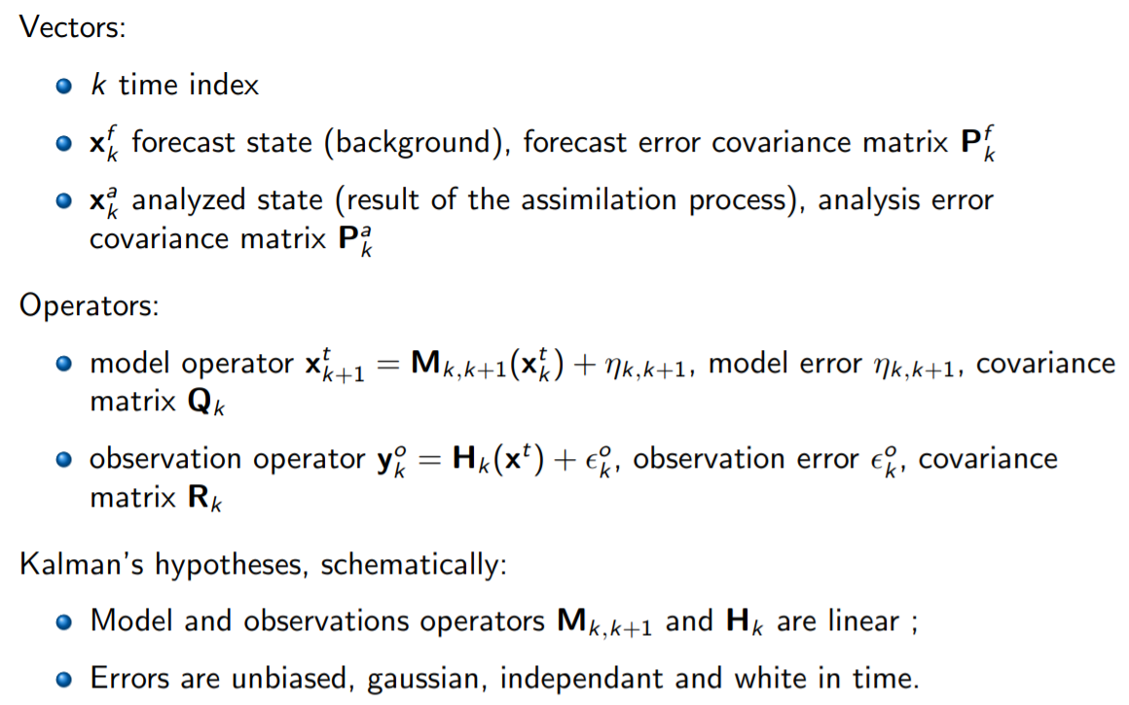
Sequantial DA: Kalman filter
Variational and sequential DA

Slide 9
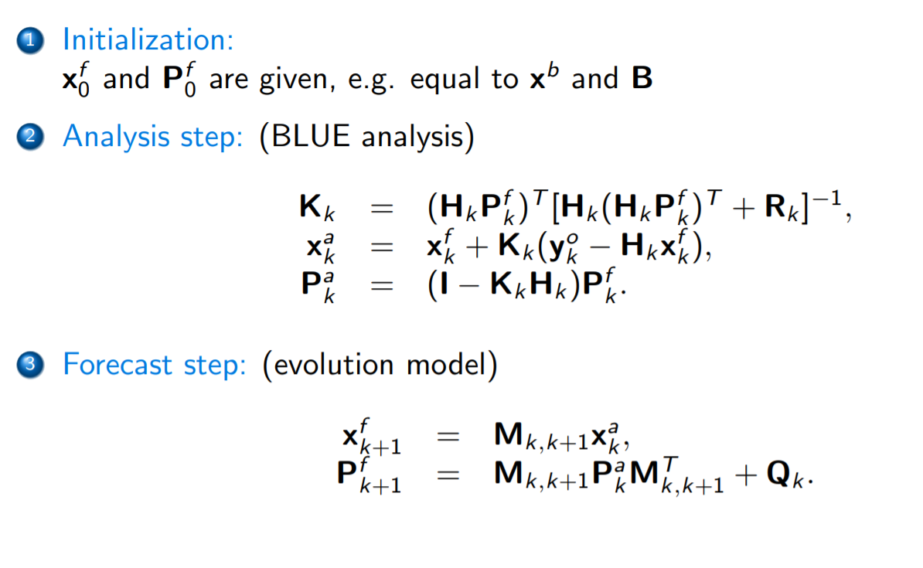
Sequantial DA: Kalman filter
Variational and sequential DA

Slide 10
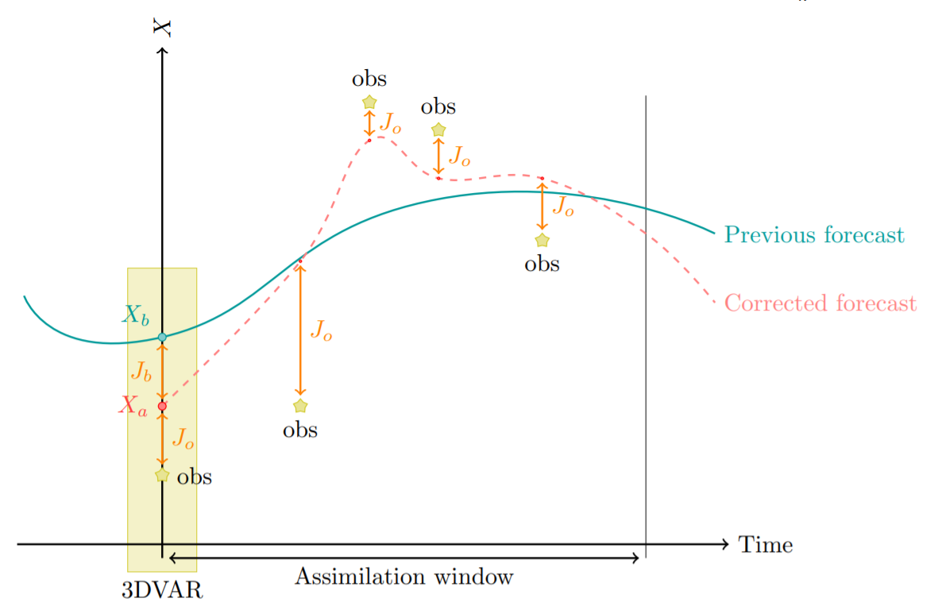
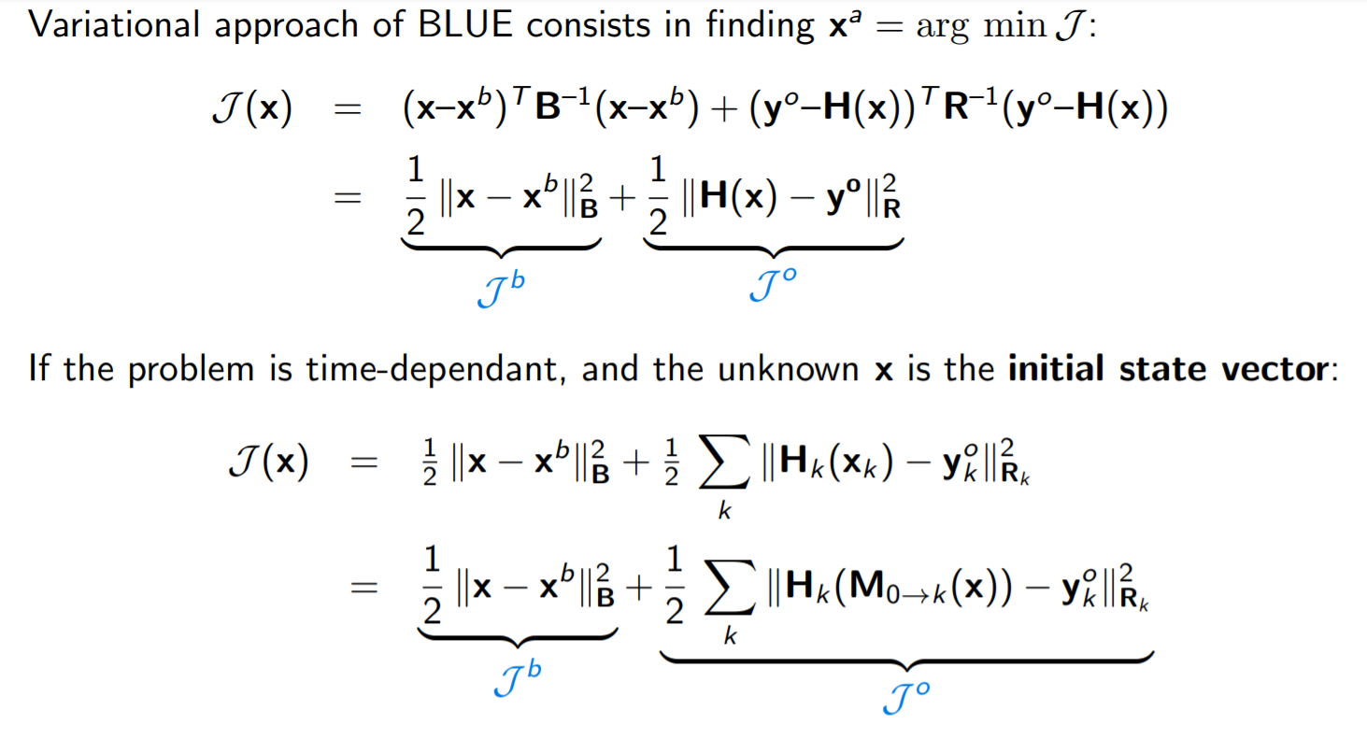
Variational DA
Variational and sequential DA

Slide 11
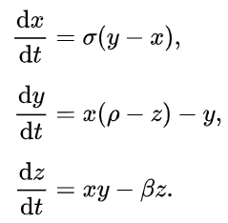

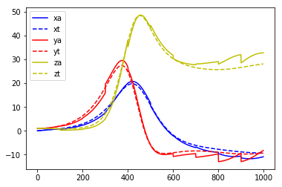
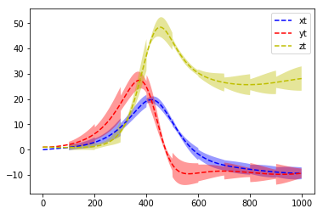
DA example: Lorenz

Slide 12
Challenges in DA
Non-linearity
H and M can be srongly non-linear
solutions: Extended Kalman filter (EKF), ensemble methods…
Unknown error covariances
B and R are difficult to be specified a priori
solutions: Iterative covariance computing, ensemble methods…
Large dimension
up to 10e9 for field reconstrunction
solutions: POD, auto-encoder, Adjoint modelling…

Slide 13
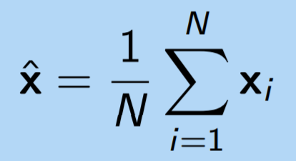
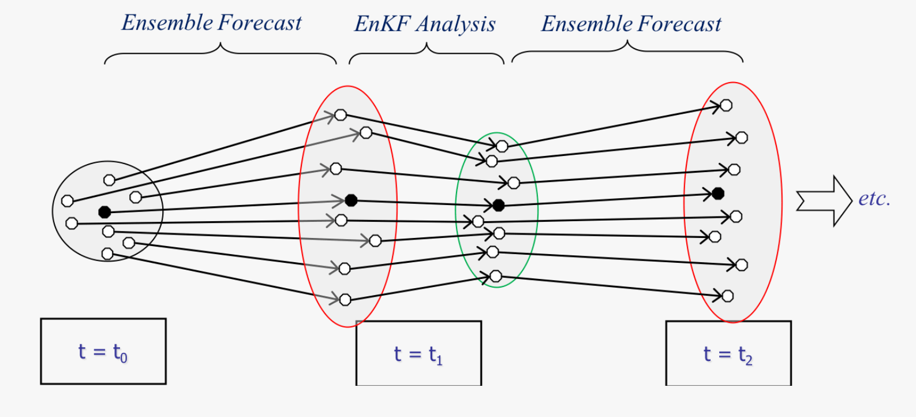
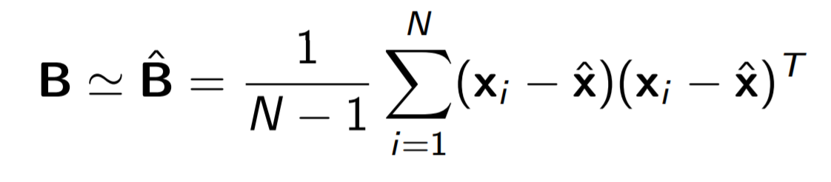
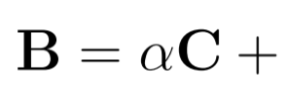
Non-linearity: Ensemble DA
Challenges in DA
Generate an ensemble of background states at the beginning

Slide 14
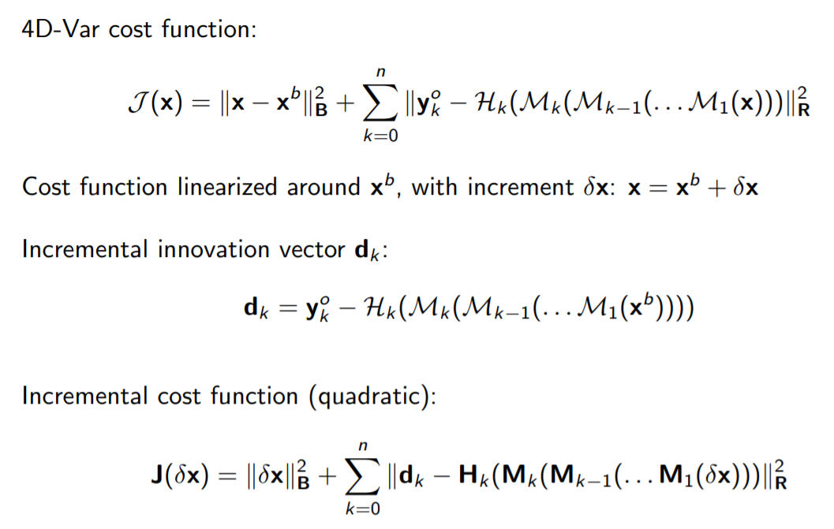
Non-linearity: Incremental assimilation
Challenges in DA

Slide 15
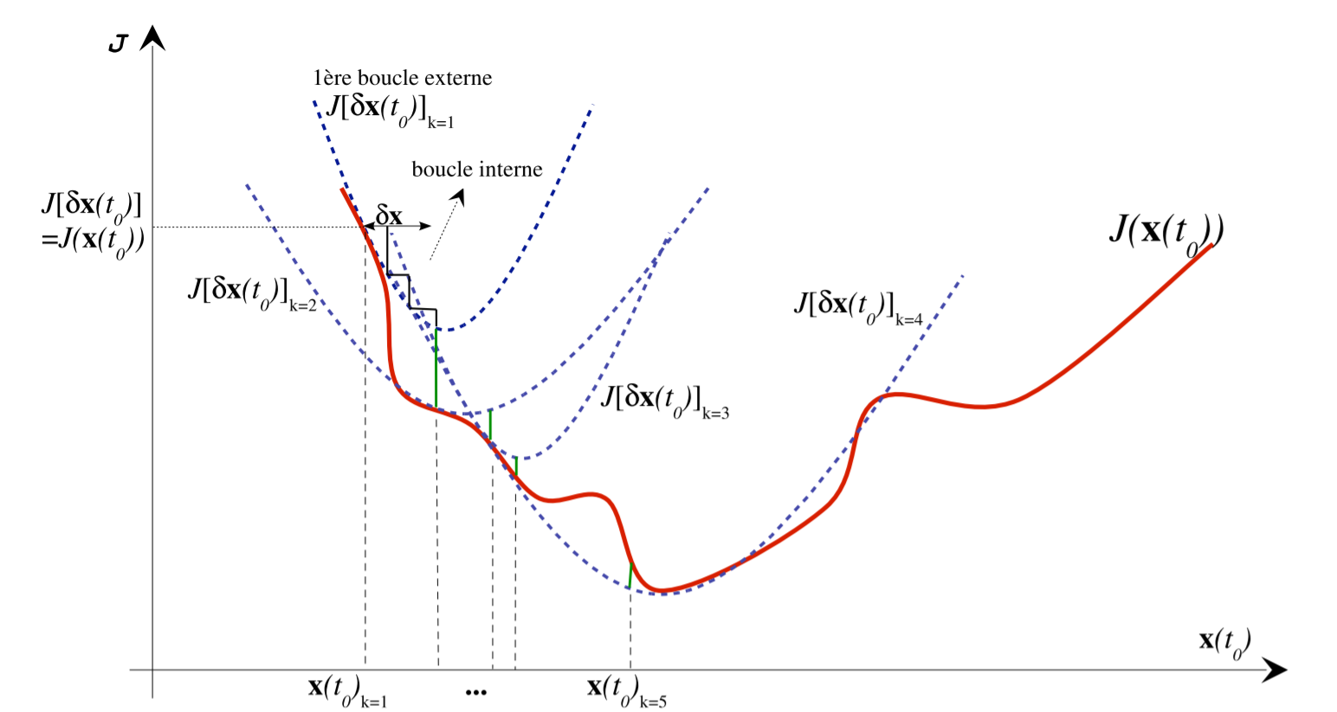
Non-linearity: Incremental assimilation
Challenges in DA

Slide 16
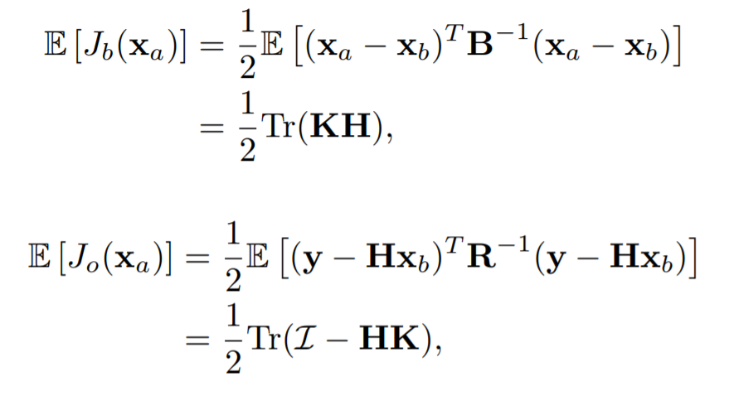
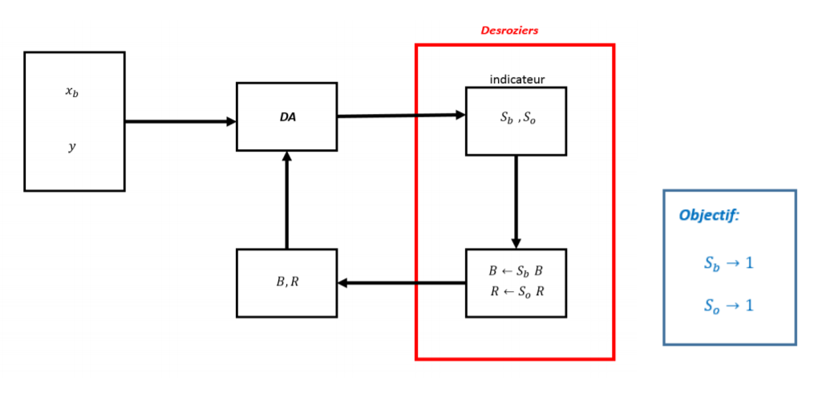
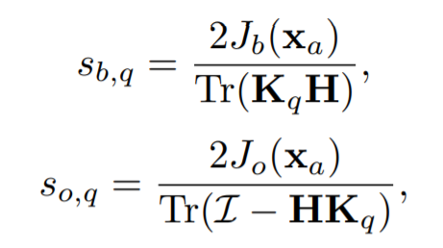
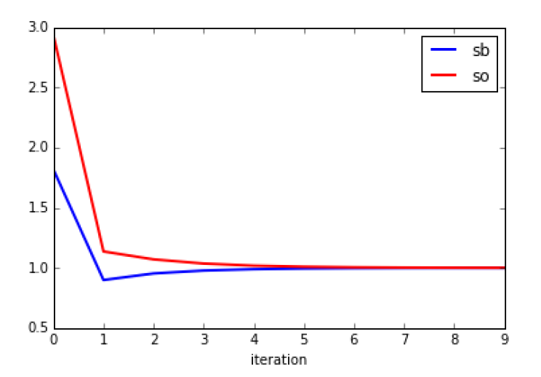
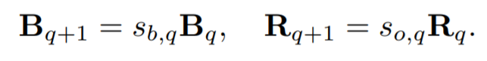
Error covariance: optimal weight
Challenges in DA
How much confidence should I give to the observations?
[Desroziers & Ivanov, 2001]

Slide 17
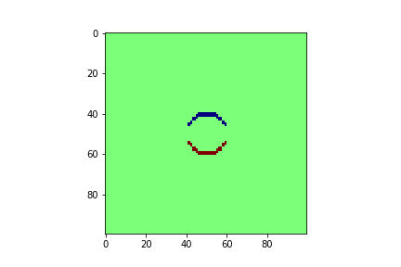
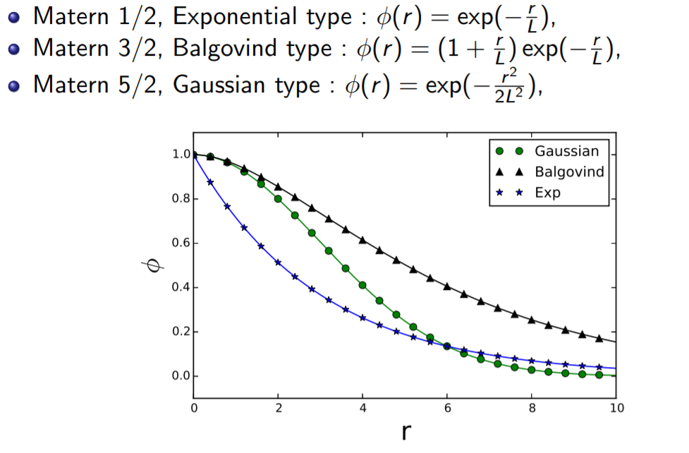
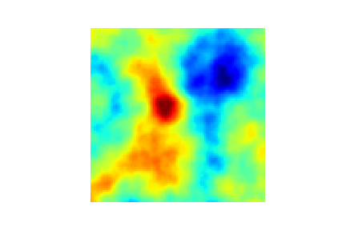
Error covariance: spatial correlation
Challenges in DA
Correlated error
Iterative covariance computing
Expectation maximization
[Cocucci et al, 2020], Model error covariance estimation in particle and ensemble Kalman filters using an online expectation-maximization algorithm
Residual-based approaches
[Desroziers et al, 2005], Diagnosis of observation, background and analysis‐error statistics in observation space
Invariant observation updating
[Cheng et al, 2019] Background error covariance iterative updating with invariant observation measures for data assimilation

Slide 18
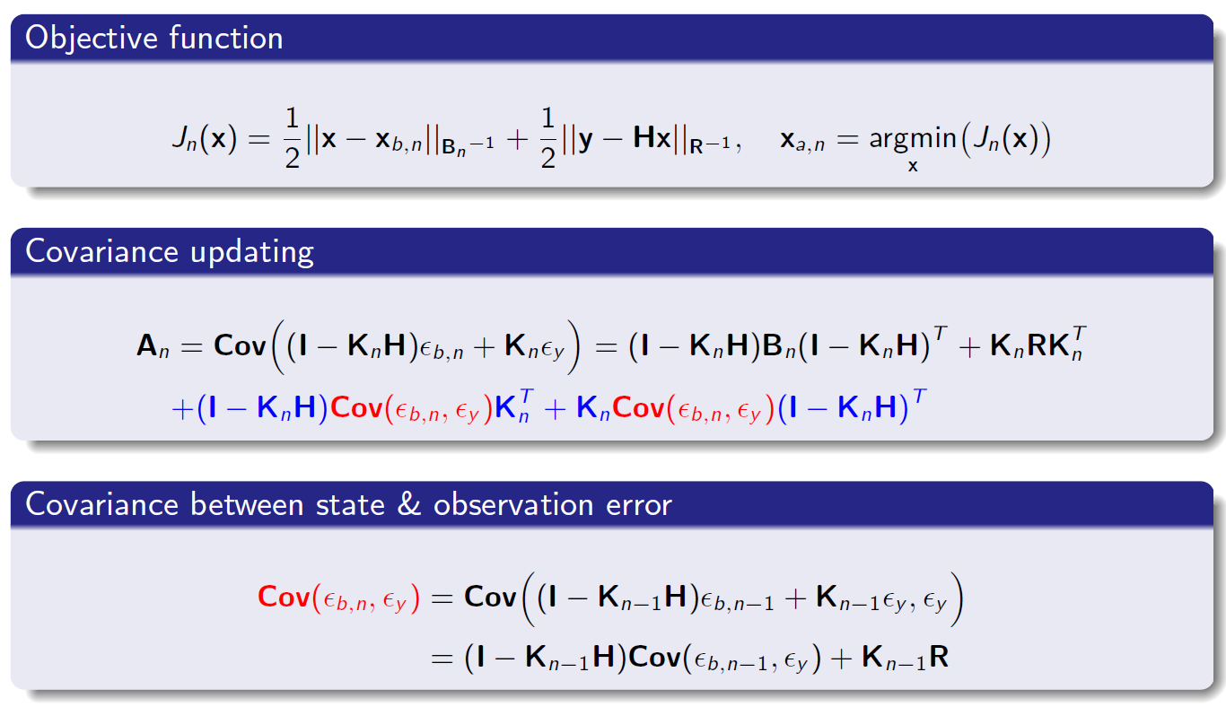
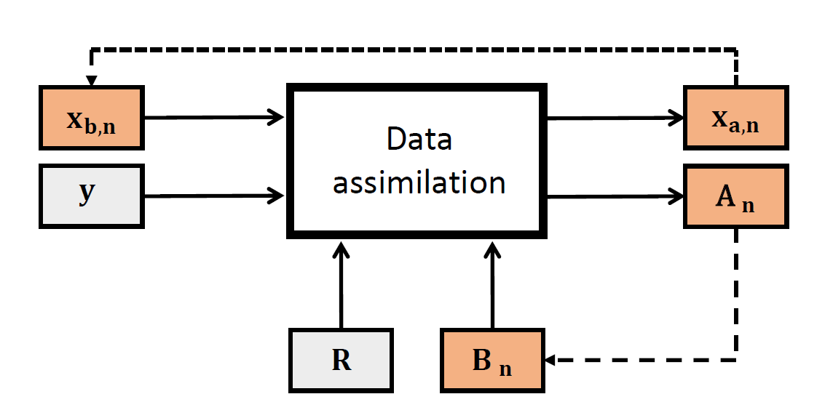
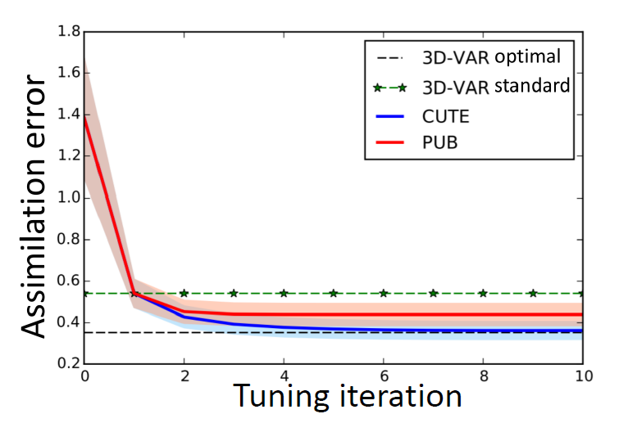
Invariant observation updating
Challenges in DA
[Cheng et al, 2019] Background error covariance iterative updating with invariant observation measures for data assimilation

Slide 19
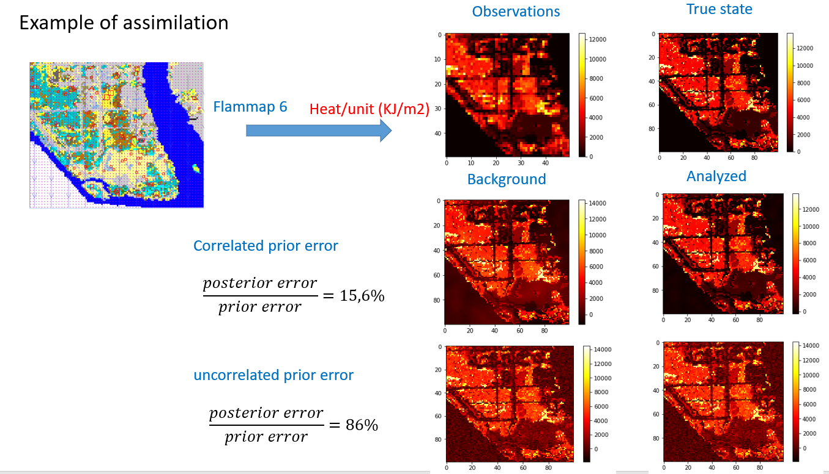
Error covariance modelling
Challenges in DA

Slide 20
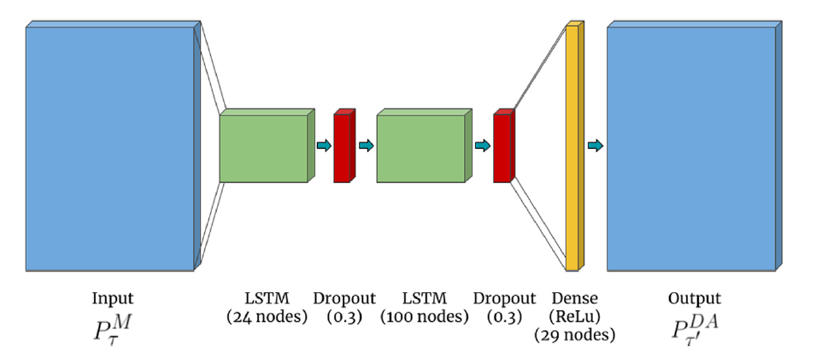
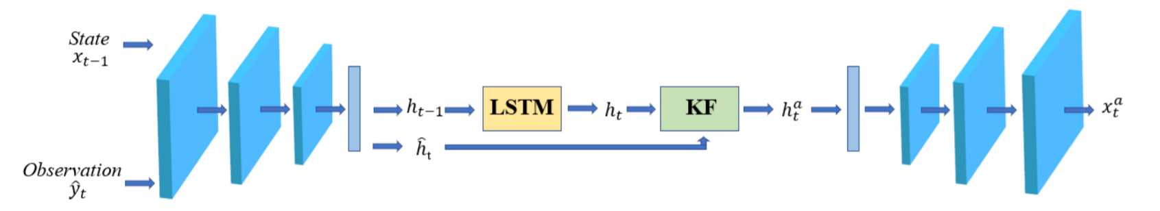
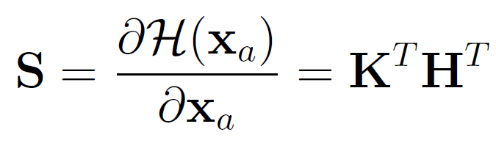
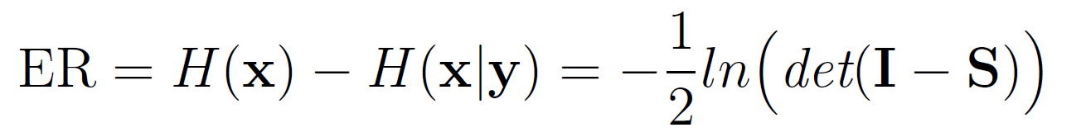
Model reduction
Challenges in DA
Proper orthogonal decomposition (POD)
[Arcucci et al, 2018] Optimal reduced space for Variational Data Assimilation
[Casas et al, 2020] A Reduced Order Deep Data Assimilation model
Autoencoder
[Mark et al, 2020] Attention-based Convolutional
Autoencoders for 3D-Variational Data Assimilation
[Amendola et al, 2021], Data Assimilation in the
Latent Space of a Neural Network
Obervation compression
[Cheng et al, 2021] Observation data compression for variational
assimilation of dynamical systems

Slide 21
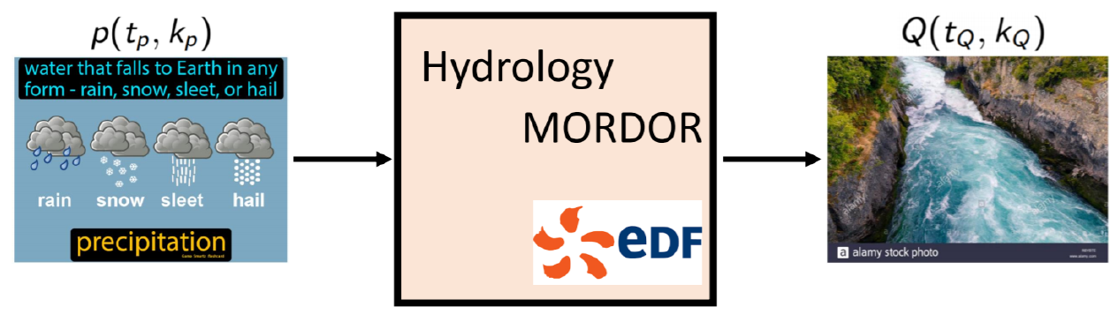
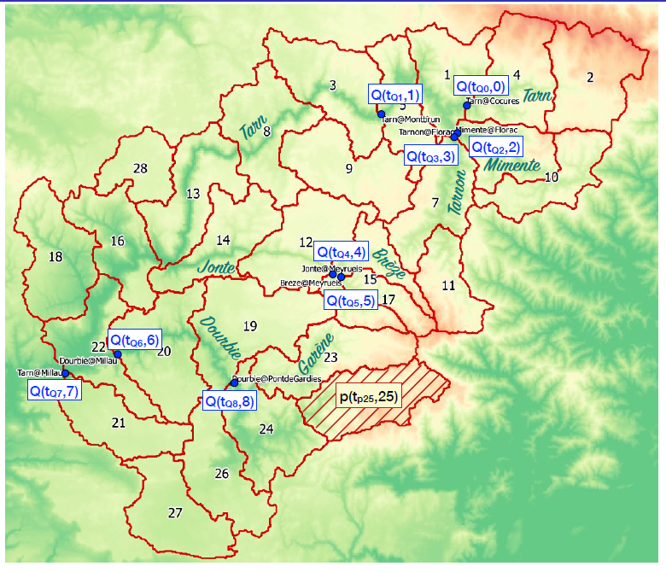
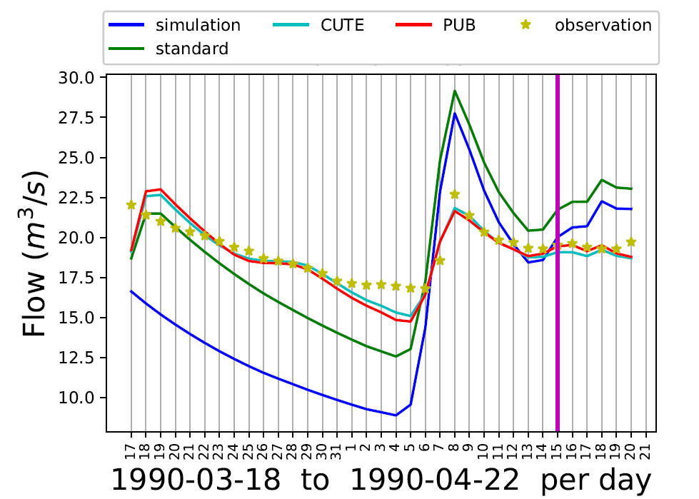
DA applications: Hydrological model
[Cheng et al, 2020] Error covariance tuning in variational data assimilation: application to an operating hydrological model

Slide 22
References
Ensemble Data Assimilation, Robert G., Pennstate University
Background Error Covariance Modelling, Mike Fisher, 2003
Introduction to Data Assimilation, Maelle Nodet, Universit´e de Grenoble, 2012

Slide 23
Thank You

